Slide 1

ITI
Introduction to Computer Networks & Cyber Security Prepared By : Mohamed AboSehly

Slide 2
Part 2 (Cyber Security Essentials)
Cyber Security Essentials

Slide 3
Part 2 (Cyber Security Essentials)
Session Outlines
Information Security Goals
Confidentiality ,Integrity, Availability
Risks & Threats
Threats & Vulnerabilities
Attackers methodology & Methods
Malware Types
Security Defenses
Firewalls (Static & Dynamic firewalls)
IDS /IPS
VPN
Proxy
Next generation Firewalls
Encryption
Symmetric & Asymmetric Key Cryptography
Digital Signatures /Digital Certificates

Slide 4

Part 2 _Introduction
People use networks to exchange sensitive information with each other.
People purchase products and do their banking over the Internet.
We rely on networks to be secure and to protect our identities and our private information
Cyber Security is a shared responsibility that each person must accept when they connect to the network.
Notes:
Objective: to learn about the threats that exist on the network and how we can do our part to protect our computers and information.

Slide 5

Part 2 _Cyber Security
Cyber Security
How to protect systems, networks, programs, devices and data from cyber attacks
Network security is the implementation of security devices, policies, and processes to prevent the unauthorized access to network resources or the alteration or destruction of resources or data.
Security involves protecting resources:
End-user resources: PCs, Laptop, Tablets
Network resources: Routers, Switches
Server resources: Rack Mount, Blade servers
Notes:
End-user resources: client workstations like firewall, complex password, antivirus, shared resource like folders
Network resources: Routers, switches, firewall: no any one access the router or switch except the admin, port security ,shutdown unused prots
Server resources: WWW, Email, FTP servers :make delegation

Slide 6
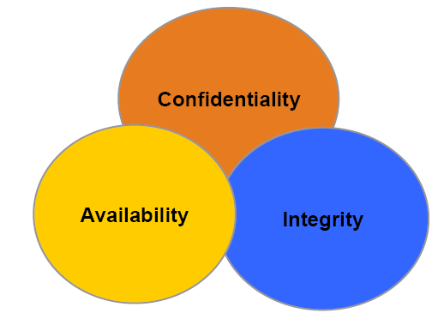
Part 2 _Security Goals
C . I . A

Slide 7
Part 2 _Security Goals
Confidentiality
Ensuring that information is not revealed to unauthorized persons
Data transmitted or stored should only be revealed to an intended audience
Integrity
Ensuring consistency of data
It should be possible to detect any modification of data
Availability
Ensuring that legitimate users are not denied access to information and resources

Slide 8
Part 2 _Focus of Security is Risk
Security deals with managing risk to your critical assets
It's impossible to totally eliminate risk
Security 99.9 % Not found Why ?
This can be seen through the different types of attacks that users face today.
New technologies / applications
New Vulnerabilities
the difficulties in defending against these attacks
Risk = Threat x Vulnerabilities
Vulnerability is the degree of weakness which is found in every network and device.
Threats is A person, thing, event or idea which poses danger to an asset in terms of that asset’s confidentiality, integrity, availability or legitimate use

Slide 9
Part 2 _Attackers Terminologies
Black hats
Individuals with extraordinary computing skills, resorting to malicious or destructive activities.
Known as ‘Crackers.’
White Hats
Individuals professing hacker skills and using them for defensive purposes.
Known as ‘Security Analysts, Ethical hacker’.
Gray Hats
Individuals who work both offensively and defensively at various times.

Slide 10
Part 2 _What does a Malicious Hacker Do?
Reconnaissance
Scanning
Gaining access
Maintaining access
Covering tracks

Slide 11




Part 2 _Reconnaissance (Phase 1)
Reconnaissance refers to the preparatory phase where an attacker seeks to gather as much information as possible about a target of evaluation prior to launching an attack.
Gathering info about internal structure of organization, by browsing and search the internet
Notes:
Hackers use public data networks and forums to get info about specific network those resources are
1-discussions of employees on public forum
2-public DB
3-public monitoring DB websites---www.netcraft.com –to know which operating system is running, and web server used
1- system admins always use public forums to troubleshoot their network problems and give details a bout network devices, OS, applications and IPs
Hackers could search by the domain name or employee name or email to search this data
2-public DB like Whois DB, www.arin.net from which I could know IP ranges of organization, also if it has its own application or another network responsible for it

Slide 12
Part 2 _ Scanning (Phase 2 )
Scanning refers to pre-attack phase when the hacker scans the network with specific information gathered during reconnaissance.
Scanning for open ports, operating systems, applications, open shares,

Slide 13
Lab
In your lab use A port scanner tools to find the open ports on your device

Slide 14
Part 2 _Gaining Access (Phase 3)
Gaining Access refers to the true attack phase. The hacker exploits the system.
The exploit can occur over a LAN, locally, Internet.
Examples include buffer overflows, denial of service, session hijacking etc.

Slide 15
Part 2 - Maintaining Access (Phase 4)
Maintaining Access refers to the phase when the hacker tries to retain his ‘ownership’ of the system.
Sometimes, hackers harden the system from other hackers as well (to own the system).
Notes:
Like creating user account for administrators group, and delete guest account to not allow any other user to access system,
Or close port no on the application, or disable service that let me access the device.

Slide 16
Part 2- Covering Tracks(Phase 5)
Covering Tracks refers to the activities undertaken by the hacker to extend his misuse of the system without being detected.
Reasons include need for continued use of resources, removing evidence of hacking, avoiding legal action etc.
Hackers can remain undetected for long periods.
Notes:
Removing to logs
Send rst request –to rest connection

Slide 17

Part 2 _Attacks
Attack is any attempt to destroy, expose, alter, disable, steal or gain unauthorized access to or make unauthorized use of an asset

Slide 18
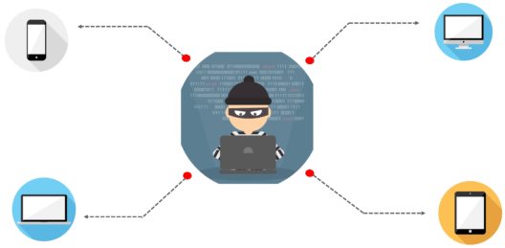
Part 2 _Attack Types
Passive Attack
Active Attack
Phishing Attack
Hijack Attack
Spoof Attack
Buffer Overflow Attack
Exploit Attack
Password Attack

Slide 19


Part 2_Passive attack VS Active attack
Passive attack attempts to take the information from the system and does not affect any system resources and its operations.
Ex : Cookies , Spyware , Wireshark
Active attack attempts to change the system resources or affect their usual operations.
Ex : Ransomware, Viruses, worms

Slide 20
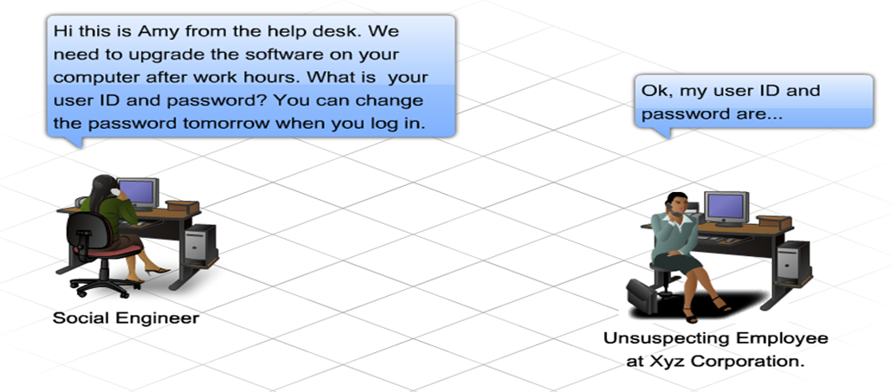
Part 2_ Social engineering
Social engineering is a term that refers to the ability of something or someone to influence the behavior of a group of people.
Notes:
In the context of computer and network security Social Engineering refers to a collection of techniques used to deceive internal users into performing specific actions or revealing confidential information.

Slide 21
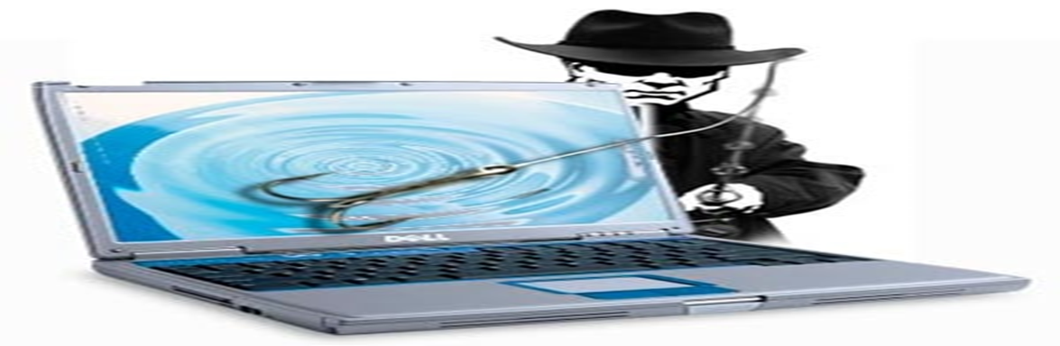
Part 2_PHISHING ATTACK
In phishing attack
the hacker creates a fake web site that looks exactly like a popular site.
The phishing part of the attack is that the hacker sends
An e-mail message , Sms message
trying to trick the user into clicking a link that leads to the fake site.
When the user attempts to log on with their account information, the hacker records the username and password and then tries that information on the real site.

Slide 22
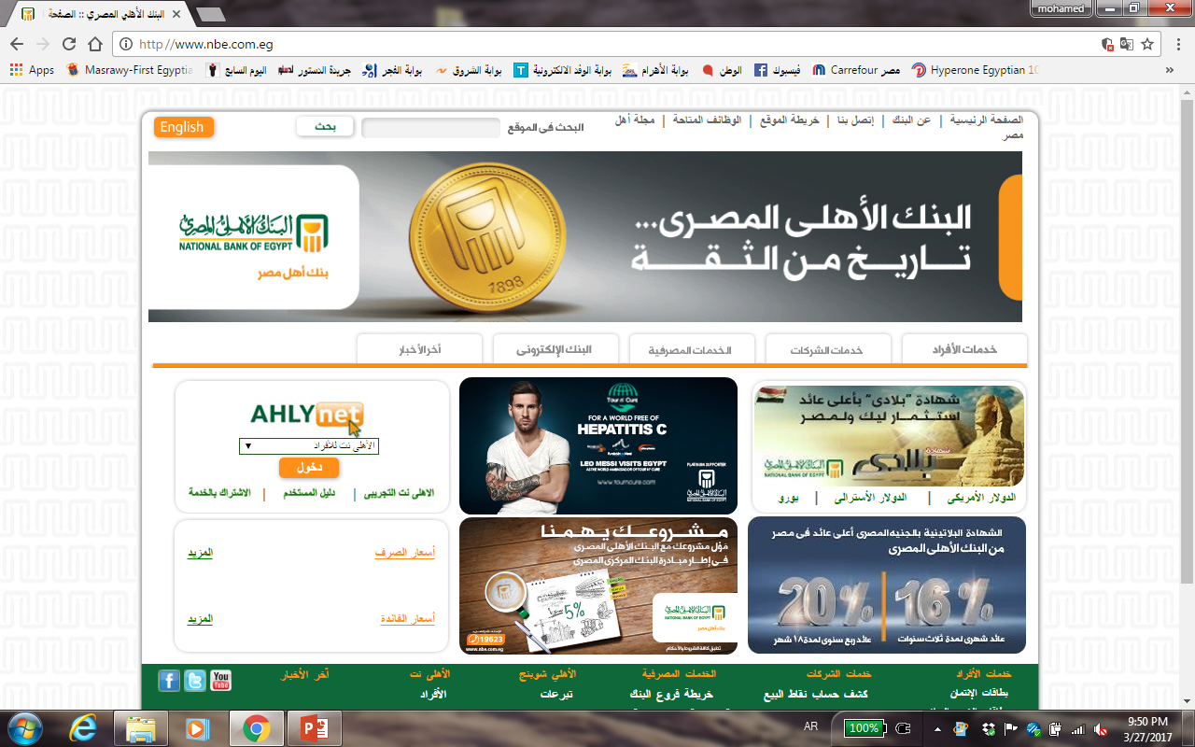

Part 2_Find the fake one ?

Slide 23
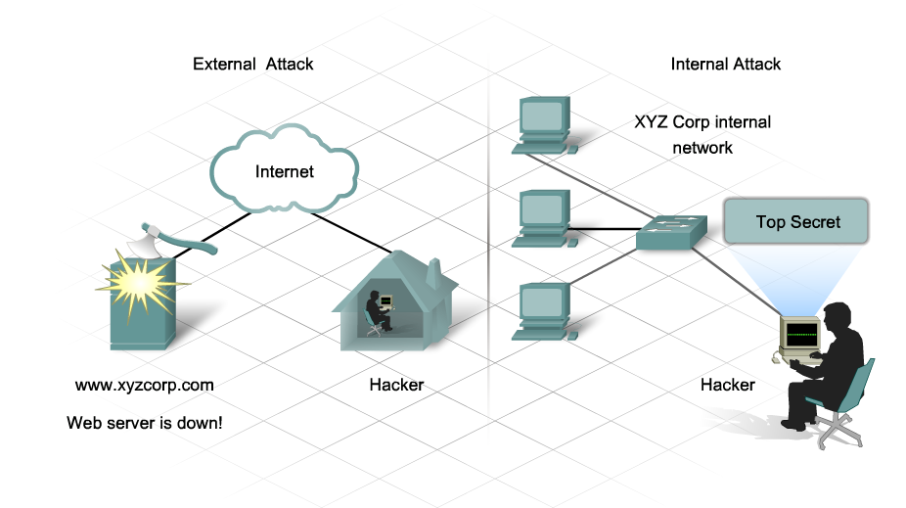
Part 2_Insider Attack

Slide 24
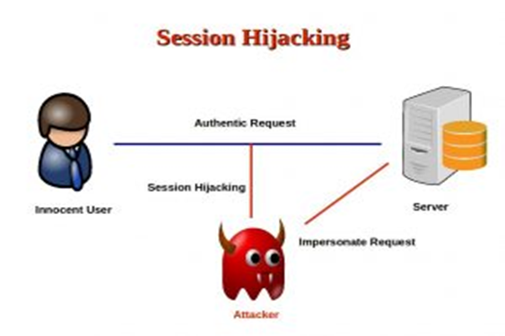
Part 2_HIJACK ATTACK
In a hijack attack, a hacker takes over a session between you and another individual and disconnects the other individual from the communication. You still believe that you are talking to the original party and may send private information to the hacker by accident.

Slide 25
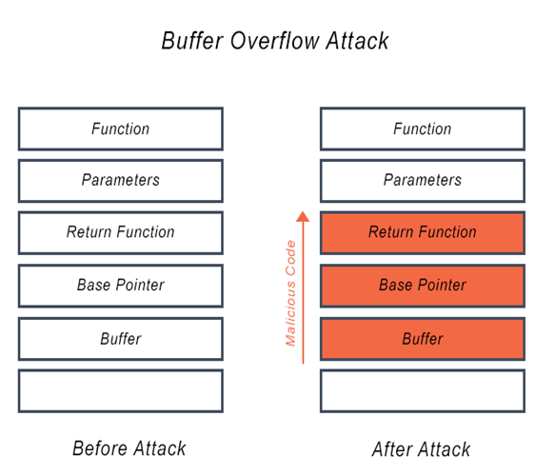
Part 2_BUFFER OVERFLOW ATTACK
A buffer overflow attack is when the attacker sends more data to an application than is expected. A buffer overflow attack usually results in the attacker gaining administrative access to the system in a command prompt or shell.

Slide 26

Part 2_PASSWORD ATTACK
An attacker tries to crack the passwords stored in a network account database or a password-protected file.

Slide 27
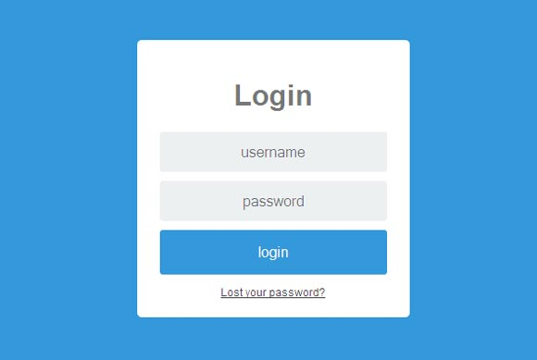
Part 2_types of password attack
Dictionary attack
Brute-force attack
Hybrid attack.

Slide 28
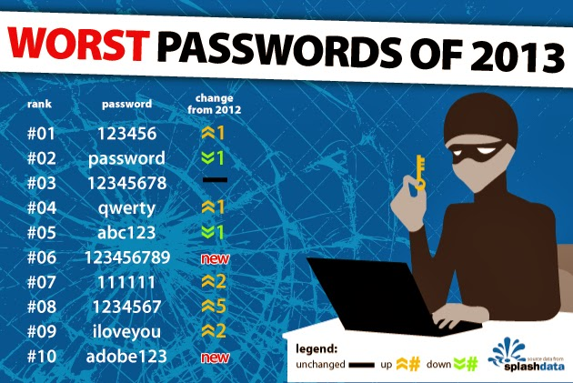
Part 2_types of password attack
A dictionary attack uses a word list file, which is a list of potential passwords.

Slide 29
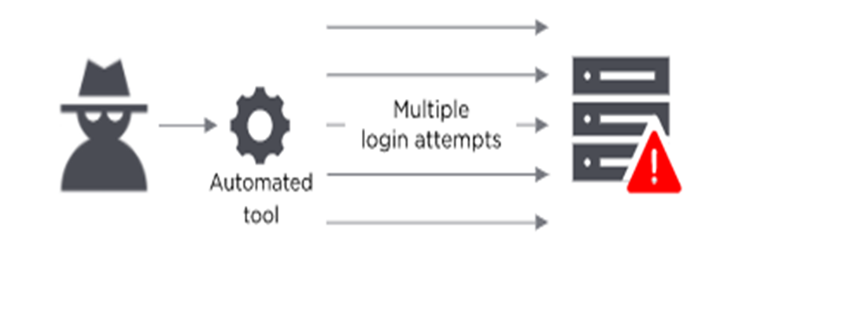
Part 2_TYPES OF PASSWORD ATTACK
A brute-force attack is when the attacker tries every possible combination of characters.

Slide 30
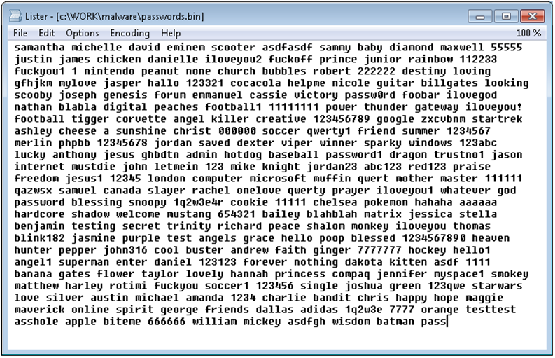
Part 2_types of password attack
A hybrid attack builds on the dictionary attack method by adding numerals and symbols to dictionary words

Slide 31
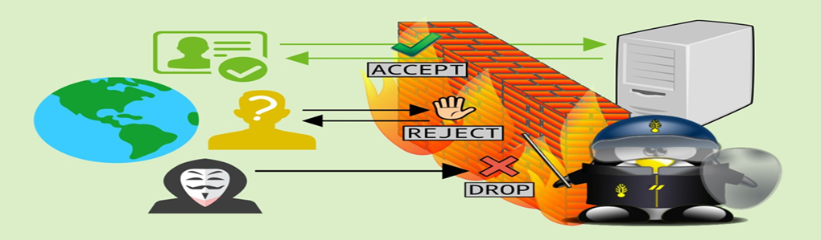
Part 2_SPOOF ATTACK
In a spoof attack, the hacker modifies the source address of the packets he or she is sending so that they appear to be coming from someone else. This may be an attempt to bypass your firewall rules.

Slide 32
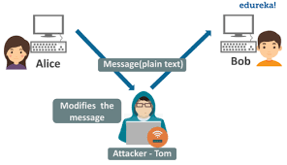
Part 2_Man in the middle Attack
Notes:
attack is a well known attack where an attacker sniffs packets from network, modifies them and inserts them back into the network.
man-in-the-middle, based on the ball game where a number of people try to throw a ball directly to each other while one person in between them attempts to catch it .

Slide 33
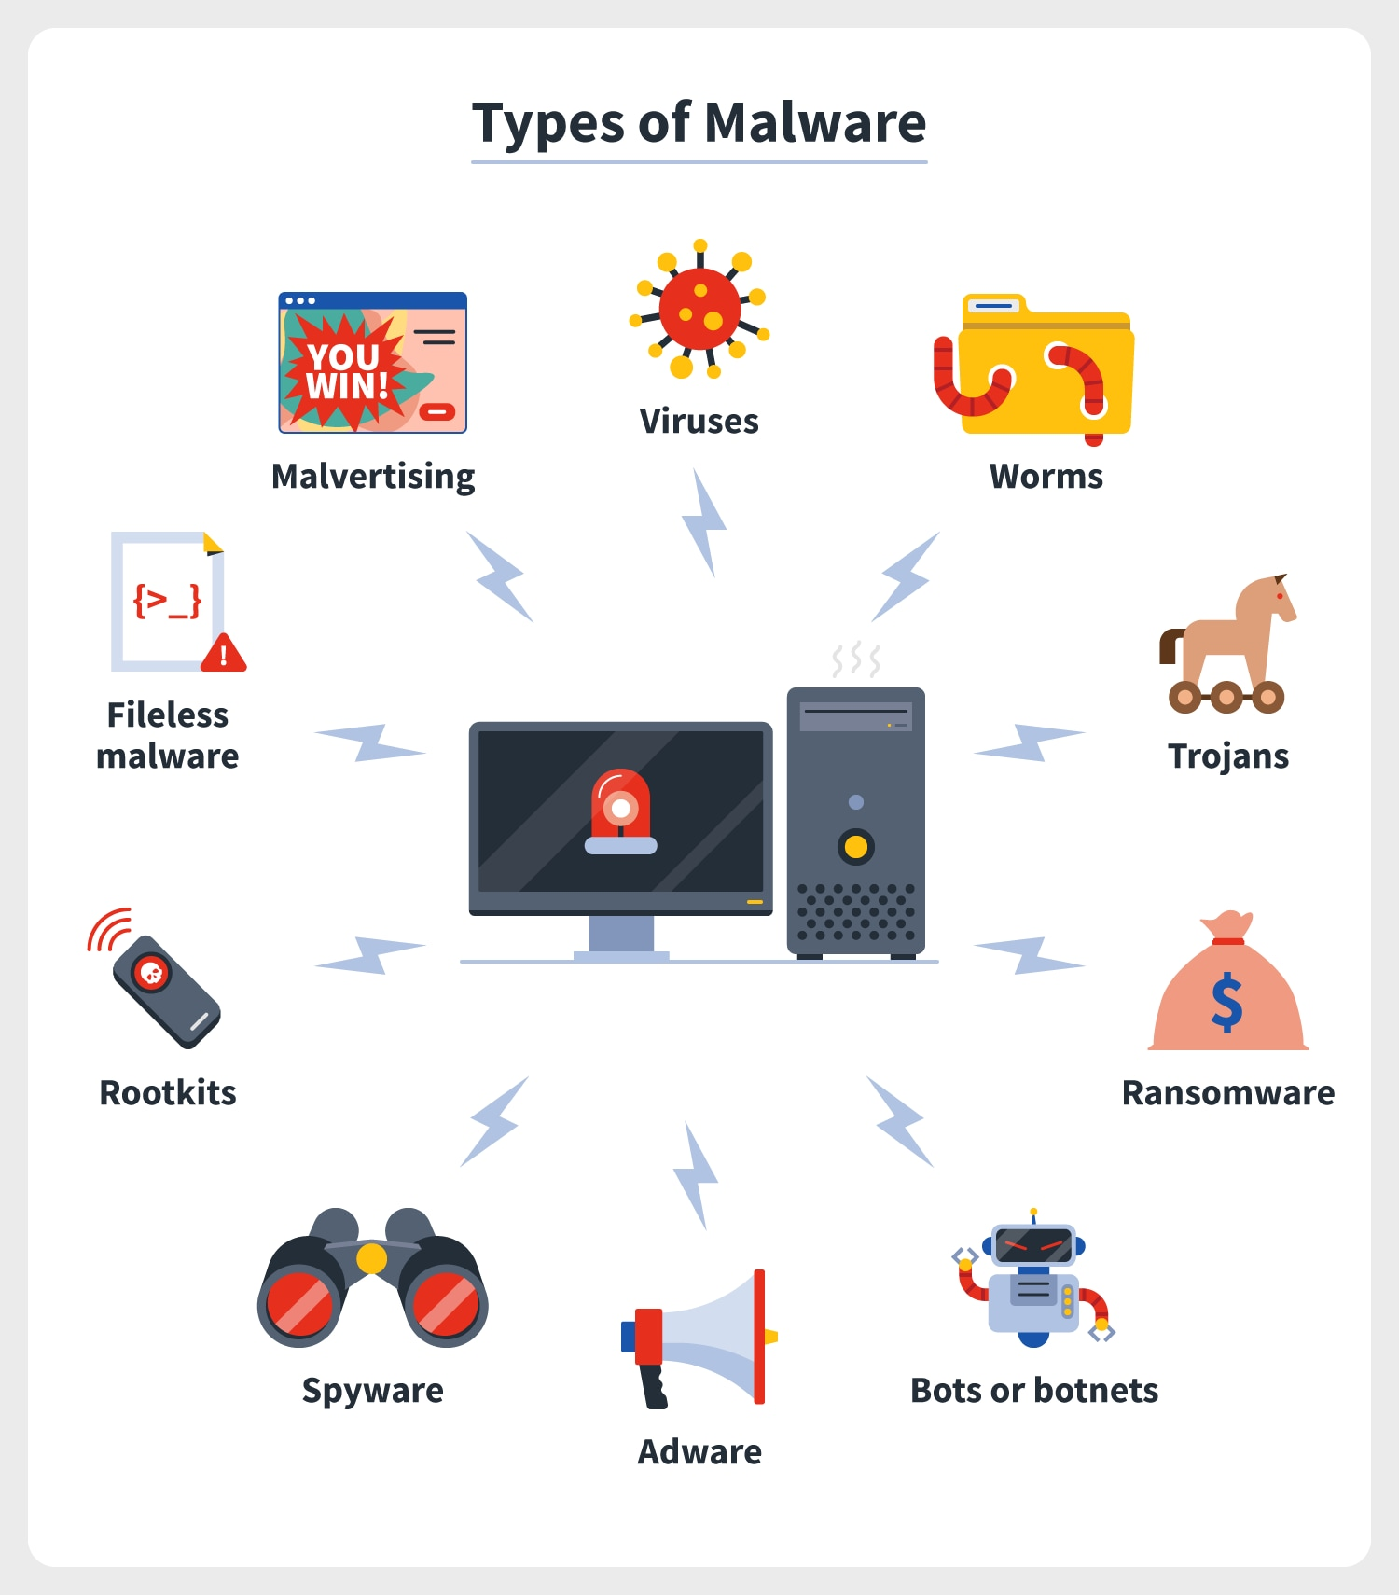
Part 2_Malware Types
Malware Capabilities
Destruction of Data
Leaking Confidential Information
Providing Backdoor Access
Countless Other Opportunities

Slide 34
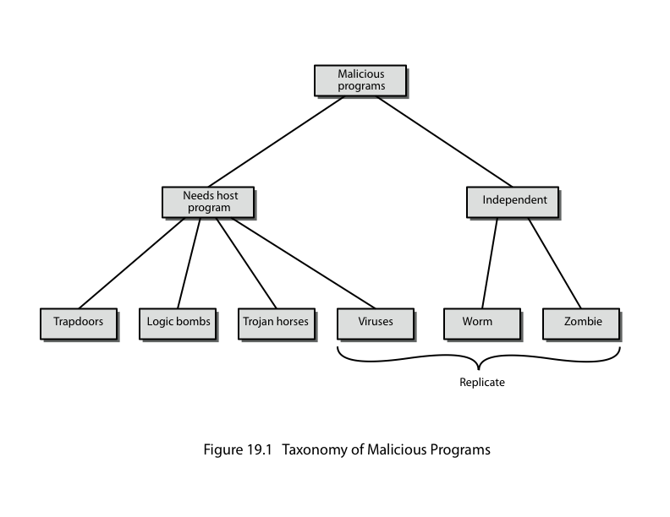
Part 2_Malicious Software
Notes:
The terminology used for malicious software presents problems because of a lack of universal agreement on all terms and because of overlap.
It can be divided into two categories: those that need a host program (being a program fragment eg virus), and those that are independent programs (eg worm);
alternatively you can also differentiate between those software threats that do not replicate (are activated by a trigger) and those that do (producing copies of themselves).

Slide 35

Part 2_Backdoor or Trapdoor
Secret entry point into a program
Allows those who know access bypassing usual security procedures
Have been commonly used by developers
Requires good s/w development & update
Can’t be removed or scanned and the only way is to uninstall sw or format the system
Notes:
A backdoor, or trapdoor, is a secret entry point into a program that allows someone that is aware of it to gain access without going through the usual security access procedures.
Have been used legitimately for many years to debug and test programs, but become a threat when left in production programs.
It is difficult to implement operating system controls for backdoors.
Security measures must focus on the program development and software update activities.

Slide 36
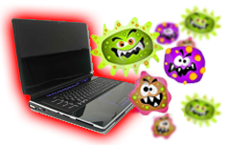
Part 2_Viruses
A virus is malicious software that is attached to another program to execute a particular unwanted function on a user's workstation.
Both propagates itself & carries a payload
Carries code to make copies of itself
As well as code to perform some covert task
Notes:
A virus is a piece of software that can “infect” other programs by modifying them; the modification includes a copy of the virus program, which can then go on to infect other programs. It can be compared to biological viruses, and like them, a computer virus carries in its instructional code the recipe for making perfect copies of itself. Once a virus is executing, it can perform any function, such as erasing files and programs.

Slide 37
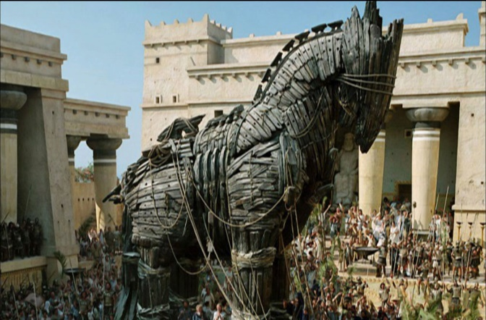
Part 2_Trojan Horse
program with hidden side-effects
which is usually superficially attractive
eg game, software upgrade etc
when run performs some additional tasks
allows attacker to indirectly gain access they do not have directly
often used to propagate a virus/worm or install a backdoor or simply to destroy data
Open some ports or pass some malicious files
Notes:
A Trojan horse is a useful, or apparently useful, program or command procedure (eg game, utility, s/w upgrade etc) containing hidden code that performs some unwanted or harmful function that an unauthorized user could not accomplish directly. Commonly used to make files readable, propagate a virus or worm, or simply to destroy data.

Slide 38
Part 2_ Independent malware
Worms
Zombie
Man in the middle
DOS
DDOS
Spyware and Tracking Cookies

Slide 39
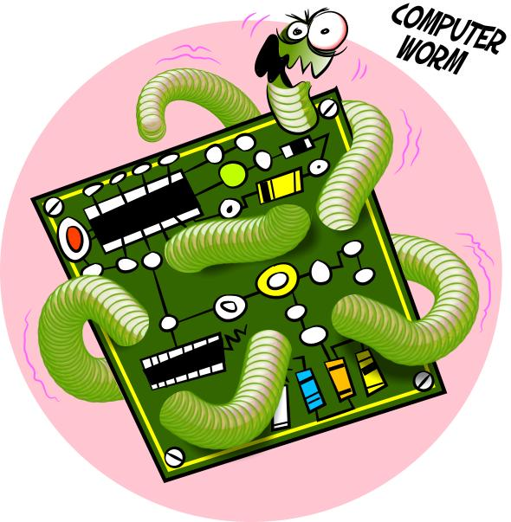
Part 2_Worms
Replicating but not infecting program
Typically spreads over a network
Using users distributed privileges or by exploiting system vulnerabilities
Widely used by hackers to create zombie pc's, subsequently used for further attacks, especially dos
Major issue is lack of security of permanently connected systems
Notes:
A worm is a program that can replicate itself and send copies from computer to computer across network connections.
Upon arrival, the worm may be activated to replicate and propagate again, and usually to also perform some unwanted function.
A worm actively seeks out more machines to infect and each machine that is infected serves as an automated launching pad for attacks on other machines. To replicate itself, a network worm uses some sort of network vehicle such as email, remote execution, or remote login.
Once active within a system, a network worm can behave as a computer virus or bacteria, or it could implant Trojan horse programs or perform any number of disruptive or destructive actions.
Deface webpage
Send malicious mails
Create backdoors
Cause denial of service to network
Let victim download or execute other malicious codes

Slide 40

Part 2_Zombie
Program which secretly takes over another networked computer then uses it to indirectly launch attacks
Often used to launch distributed denial of service (DDoS) attacks
Notes:
A zombie is a program that secretly takes over another Internet-attached computer and then uses that computer to launch attacks that are difficult to trace to the zombie’s creator. Zombies are used in denial-of-service attacks, being planted on hundreds of computers belonging to unsuspecting third parties, and then used to overwhelm the target Web site by launching an overwhelming onslaught of Internet traffic. Typically zombies exploit known flaws in networked computer systems.

Slide 41
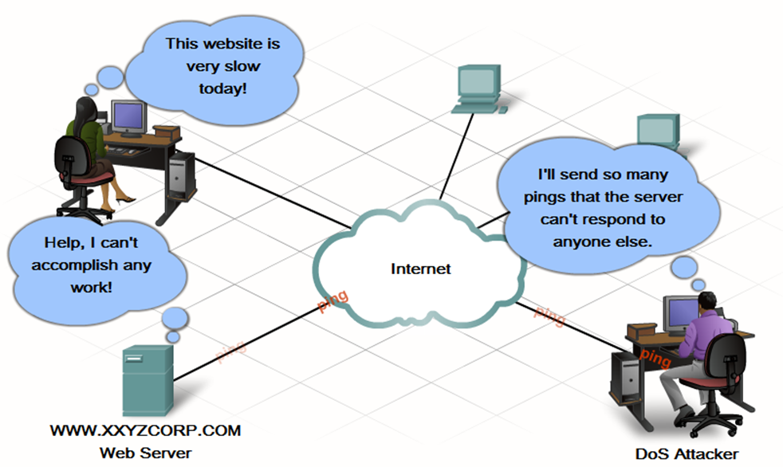
Part 2_DoS Attack
Denial of service is about without permission knocking off services, for example through crashing the whole system.
This kind of attacks are easy to launch and it is hard to protect a system against them.
Consume host resources
Memory
Processor cycles
Consume network resources
Bandwidth

Slide 42
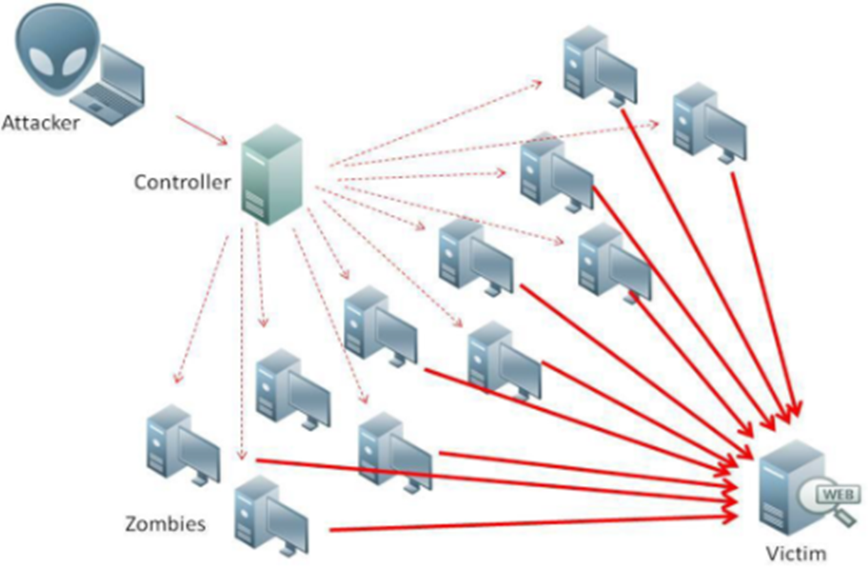
Part 2_DDoS Attack
DDoS – A distributed denial of service attack uses multiple machines to prevent the legitimate use of a service.
Making networked systems unavailable by flooding with useless traffic using large numbers of “zombies” growing sophistication of attacks
Notes:
Distributed denial of service (DDoS) attacks present a significant security threat to corporations, and the threat appears to be growing. DDoS attacks make computer systems inaccessible by flooding servers, networks, or even end user systems with useless traffic so that legitimate users can no longer gain access to those resources. In a typical DDoS attack, a large number of compromised (zombie) hosts are amassed to send useless packets. In recent years, the attack methods and tools have become more sophisticated, effective, and more difficult to trace to the real attackers, while defense technologies have been unable to withstand large-scale attacks.

Slide 43

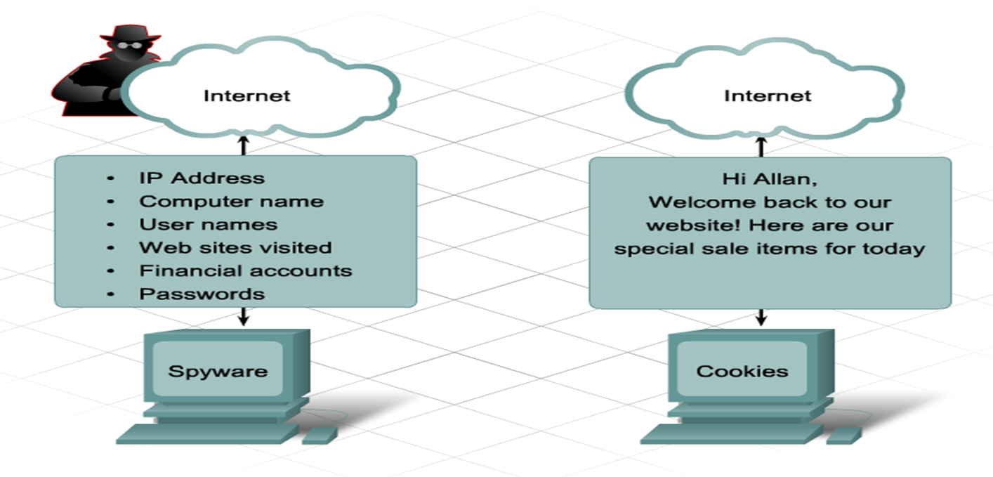
Part 2_Spyware and Tracking Cookies
Spyware
Spyware is any program that gathers personal information from your computer without your permission or knowledge. This information is sent to advertisers or others on the Internet and can include passwords and account numbers.
Tracking Cookies
Cookies are a form of spyware but are not always bad. They are used to record information about an Internet user when they visit websites.

Slide 44
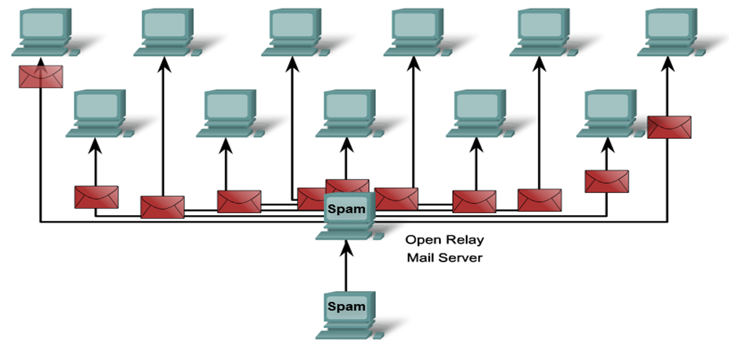
Part 2_Spam
Spam
is a serious network threat that can overload ISPs, email servers and individual end-user systems.
A person or organization responsible for sending spam is called a spammer.
Spammers often make use of unsecured email servers to forward email.
Spammers can use hacking techniques, such as viruses, worms and Trojan horses to take control of home computers.

Slide 45
Thank You

